Slide 1
DRILLING AND TAPPING

Slide 2
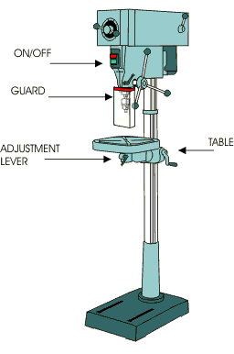
Drilling is the process of cutting holes in metals by using a drilling machine as shown.
Drills are the tools used to cut away fine shavings of material as the drill advances in a rotational motion through the material.
Drilling is done by forcing a rotating drill into stationary job as on a drilling machine
Drilling Process
‹#›

Slide 3
TYPES OF DRILLING MACHINES
Portable drilling machine
Upright drilling machine
Sensitive drilling machine
Radial drilling machine
Gang drilling machine
Multi-spindle drilling press
Automatic drilling machine
Turret drilling machine
Numerically controlled drilling machine
‹#›

Slide 4
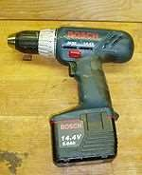
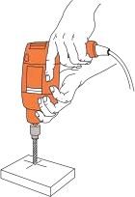
PORTABLE DRILLING MACHINE
This type of drilling machine is can carried anywhere in shop.so it is called portable.
The machine can be used for creating holes with work piece in any position which is not possible with standard drilling machines.
The entire machine is quite compact and handy.
Most of the portable drilling machines are operated by individual motors contained in the machine. Some small machines can be operated by hand.
‹#›

Slide 5
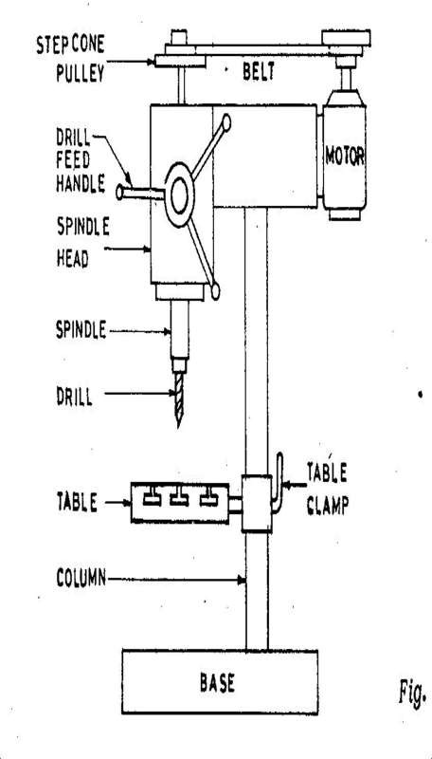
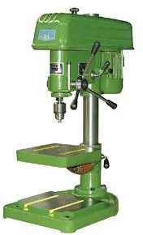
Sensitive Drilling Machines
Holes of diameter 1 mm to 15 mm.
5

Slide 6
These are small machines designed for drilling holes at high speed in light work pieces.
As shown in figure the machine consists of a vertical column, a horizontal table, a machine head mounted on the column to support the driving motor, and mechanism for driving and feeding the tool.
While feeding the operator can sense the cutting action and adjust
the feed rate so it is called sensitive drilling machine.
the machine can be fitted on a table or the floor.
Work piece with the exact location marked on it with the center punch is
clamped rigidly on the work table.
spindle axis and center punch indentation are in same line.
Machine is started and drill bit is lowered by rotating feed handle.
Drill bit touches the work and starts removing material.
Working of Sensitive Drilling Machine
‹#›

Slide 7
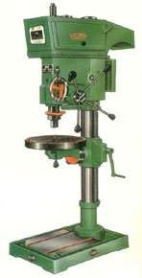
Similar in design to sensitive type but it is larger &more sturdily built.
The column may be round or of box section.
It can be raised or lowered along the pillar depending upon the height of the job clamped in position for rigidly.
The table in the case can be rotated about its own axis and clamped in position.
The swivel of the table about the pillar and rotation of the table about its center permits easy location of the job under the drill.
Upright Drilling Machine
‹#›

Slide 8
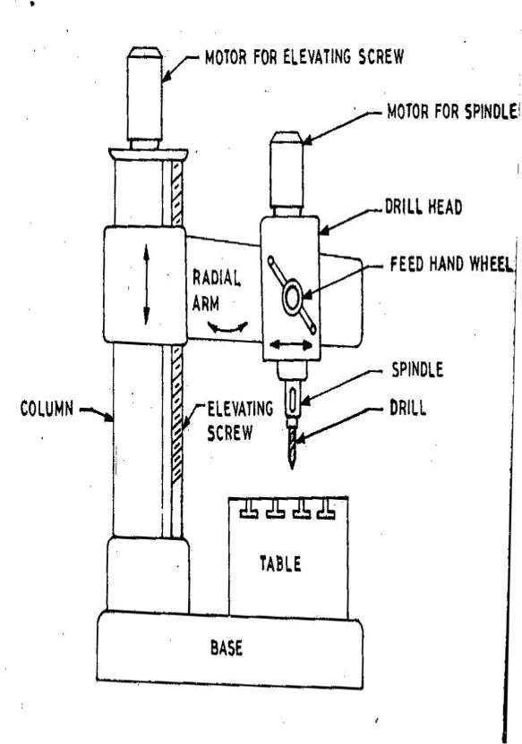
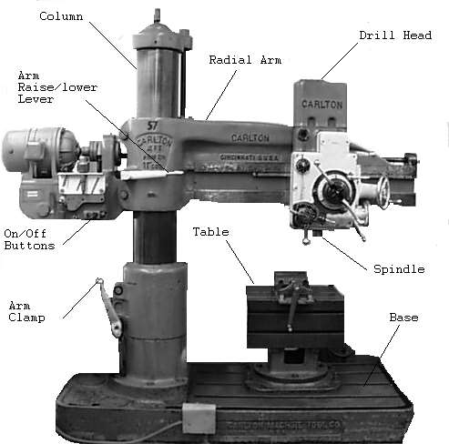
RADIAL DRILLING MACHINE
‹#›

Slide 9
The arm can be moved up and down the column and swiveled about the column and drill head also can be moved along the radial arm.
The motion of head along with the drill spindle permits positioning of holes in a circle with a radius almost as large as the length of radial arm so this is called radial drill machine.
The rotating spindle can be moved up and down relative to the arm through the feed mechanism.
Radial drilling machines are convenient for heavy jobs which cannot be moved around easily and for drilling a numbers of holes in a job.
Power feeding is also available in radial drilling machine.
Radial Drilling Machine
Holes up to 7.5 cm.
‹#›

Slide 10
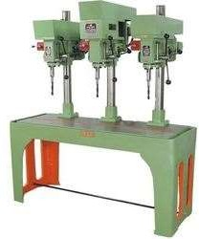
DESIGNED FOR MASS PRODUCTION
A Gang drill machine has a number of drill heads arranged with a common base and table.
Each drill head has its own power unit and carries a tool to perform an operation on a job in sequence.
The spindle may be set up with drills of different diameter or other tools as required.
The job is moved from one spindle to the other spindle for performing various operations.
Gang drilling machines are useful when several different machining cuts with different tool are to be taken on sufficiently large number of work pieces.
Gang Drilling Machine
10
Notes:
‹#›

Slide 11
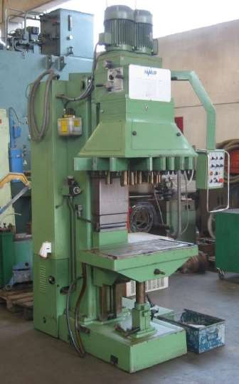
Multi-spindle drilling machines with two or more spindles driven by a common head.
This machine are used for drilling many numbers of holes simultaneously in a workpiece
They may be built as specific jobs with their spindles fixed in specific positions or as general purpose machines in which the relative distance between the spindles can be changed within a range.
Multi-spindle machines are high production rate machines and lead to considerable saving for large quantity jobs.
Multi-spindle Drilling Machine
‹#›

Slide 12
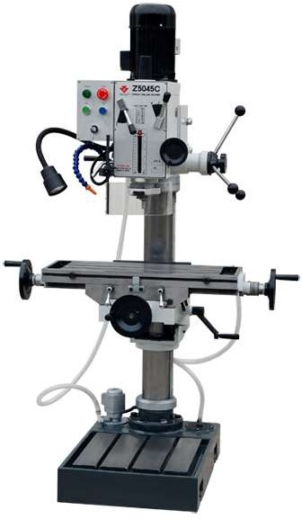
These are high performance automatic machine designed for variety of operations being done on the work piece.
A number of machines are arranged in series to perform variety of different operations on the workpiece at successive work stations.
After one operation is completed at one workstation the work piece is automatically transferred to the next work station.
Because all operation are done automatically the preciseness is higher and production time is lower.
Automatic Drilling Machine
‹#›

Slide 13
The specification of size of the drilling machine varies with type of machine.
A portable drilling machine is specific by the maximum diameter of the drill that it can be hold.
Sensitive and upright drilling machine are specified by the diameter of the largest work piece on the center of which a hole can be drilled; also by the maximum size of the drill held in steel or cast iron.
The size of radial machine is specified by the diameter of the column and length of arm.
Drill Machine Specifications
Other particular of the machine that may sometimes be specified are the table size, maximum spindle travel, spindle speeds and feed available, power of the machine, floor space required etc.
‹#›

Slide 14
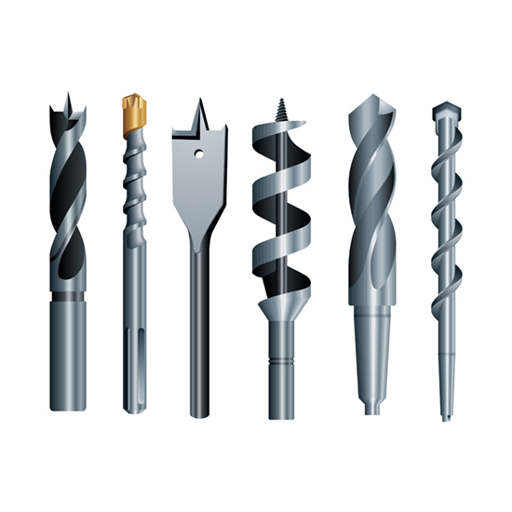
DRILL BITS
‹#›

Slide 15
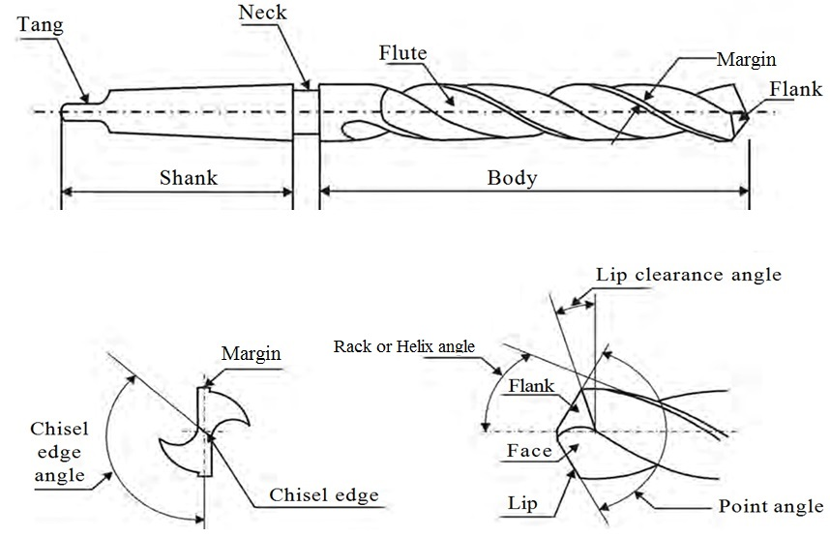
A drill bit is a multi-point tool and typically has a pointed end. A twist drill is the most common type used.
Twist drills are available with parallel shanks up to 16mm diameter and with taper shanks up to 100mm diameter
Standard lengths are known as jobber-series twist drills, short drills are known as stub series, and long drills as long series and extra long series.
Different helix angles are available for drilling a range of materials.
Drill Bits
Drill made up of
Carbon-tool steels
High-speed steel
Cemented-carbide
‹#›

Slide 16


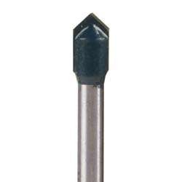


Twist Bit
Brad Point Bit
Auger Bit
Plug Cutter
Glass / Tile Bit
Drill Bit Types
‹#›

Slide 17
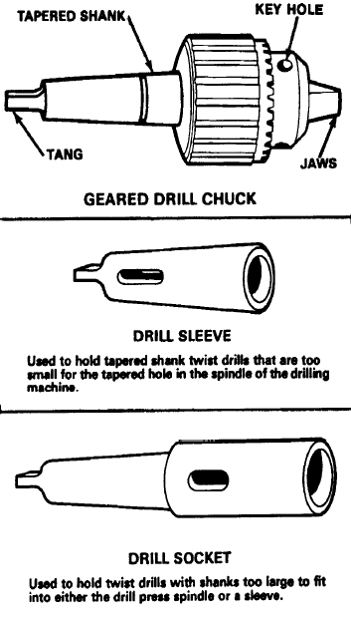
Drills and similar tools with parallel shanks are held in a drill chuck.
By rotating the outer sleeve, the jaws can be opened and closed.
To ensure maximum grip, the chuck should be tightened using the correct size of chuck key. This prevents the drill from spinning during use and chewing up the drill shank.
Tool Holding
‹#›

Slide 18
When drilling a hole on a drilling it is important that the workpiece be secured rigidly to the machine table or base.
Not properly secured work piece may be dangerous except in the case of small drills and very large work pieces.
The workpiece can be secured in many ways depending upon the size of the job and the accuracy desired.
A workpiece may be stopped from turning by fixing an obstruction on its way or it may be clamped to the machine table by using bolts or straps.
Work Holding Devices
‹#›

Slide 19
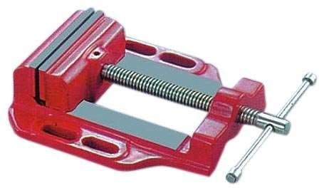
 The Machine Vice has slots in the side of the base of the vice which enable the user to screw the Machine Vice to the Drilling Machine table.
Drilling Machine Vice
‹#›

Slide 20
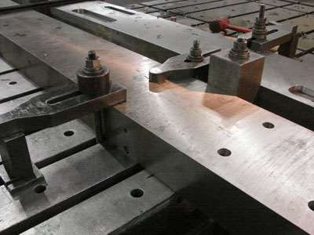
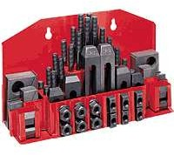
Clamping set
Direct Clamping
‹#›

Slide 21
DRILLING MACHINE OPERATION
‹#›

Slide 22
Drilling Machine Operation
Drilling
Reaming
Boring
Counter boring
Counter sinking
Spot facing
Tapping
Trepanning
Drilling Machine Operations
‹#›

Slide 23
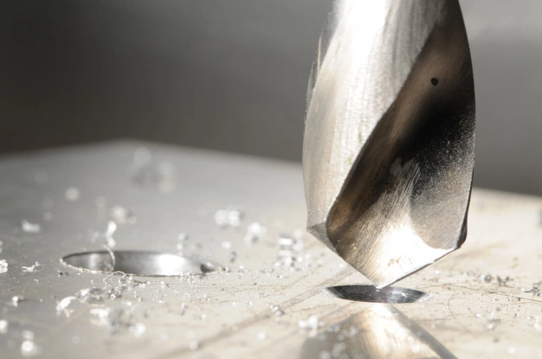
Drilling is the operation of producing circular holes in solid metal by rotating the drill and feeding it through the job. This is the main operation done on the this machine.
Before starting the drilling it is necessary to mark the position of the hole on the work piece.
Drilling process is dose not produce accurate hole. The center may not be accurate, the size of the hole is slightly larger than required.
Drilling
‹#›

Slide 24
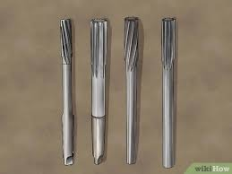
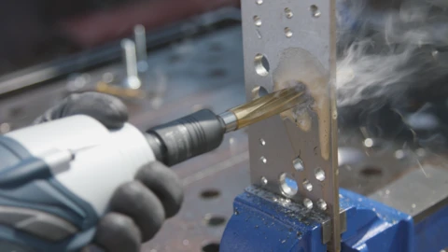
REAMING
Reaming is an operation of sizing and Enlarging a hole using a tool called reamer.
A reamer as shown on figure is multitoothed tool designed for remove relatively small amount of material from a previously drilled hole.
Reaming is done to achieve accurate hole dimension.
Initially a hole is drilled slightly smaller in size.
‹#›

Slide 25
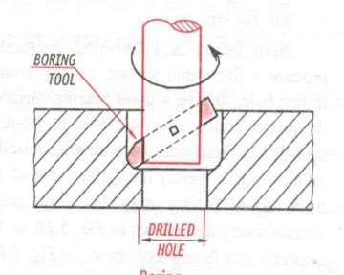
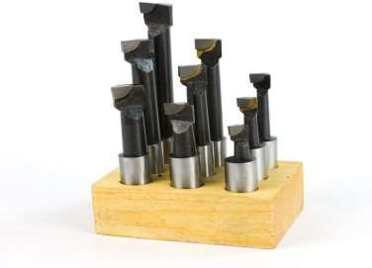
Boring is a process of aligning, sizing and finishing a cylindrical hole.
It uses single point cutting tool which rotates relative to the stationary work piece.
The hole can be aligned and sized with good surface finish.
Boring is often used to enlarge the drilled holes.
Boring
‹#›

Slide 26
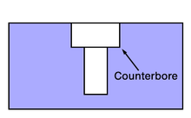
COUNTER BORING
COUNTER BORING IS THE OPERATION OF ENLARGING ONE END OF AN EXISTING HOLE CONCENTRIC WITH THE ORIGINAL HOLE WITH A SQUARE BOTTOM AS SHOWN IN FIGURE.
The counter tool known as counter bore has a pilot as shown in figure.
The pilot enters in previously drilled hole and align the tool so that the counter bored hole is concentric with the existing hole.
The tool has end cutting edges square with the axis to produce a flat bottom.
Counter boring is used to recess a bolt head or a nut below the surface to permit a mitting part to operate with obstruction.
‹#›

Slide 27
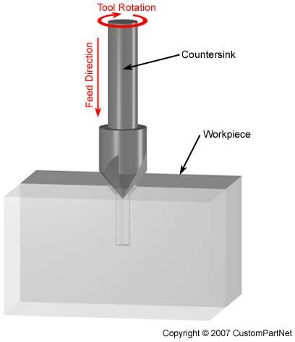
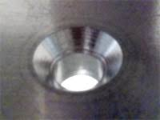
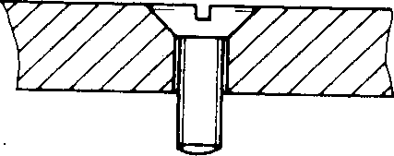
A countersink tool enlarges the top portion of an existing hole to a cone-shaped opening.
Countersinking is performed after drilling to provide space for the head of a fastener, such as a screw, to sit flush with the workpiece surface.
Common included angles for a countersink include 60, 82, 90, 100, 118, and 120 degrees.
Counter Sinking
‹#›

Slide 28
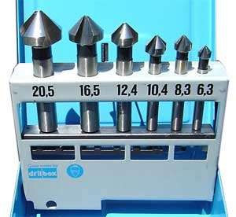
COUNTER SINKING BITS
‹#›

Slide 29
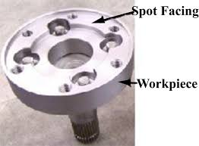


Spot facing shown in figure is the process of producing a flat machined surface generally around a hole perpendicular to the hole axis.
This flat surface allows the bottom of a screw or bolt to seat squarely
with the material.
Spot facing is commonly done on castings where irregular surfaces are found.
Spot facing may be performed on a drill press with a counter bore of suitable size for the operation.
Spot Facing
spot face
To seat a nut
‹#›

Slide 30
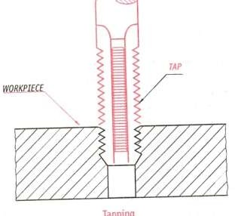
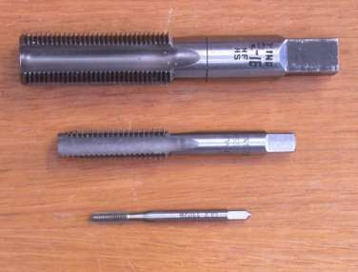
Tapping is a thread cutting for producing internal threads.
Tapping uses multi- point cutting tool called taps may be done manually or on machine like drills.
The tapping attachment used with the drill permits forward rotation of the tap when it is cutting and fast reverse rotation for withdrawal.
Tapping
‹#›

Slide 31
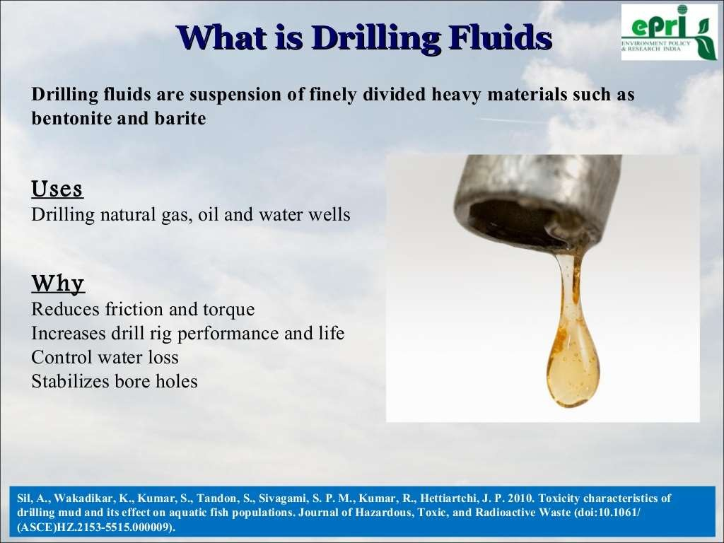
DRILLING LUBRICANTS
‹#›

Slide 32
Do not support the workplaces by hand. Use a holding device to prevent the workpiece from being tom from the operator’s hand.
Never make any adjustments while the machine is
operating.
SAFETY PRECAUTIONS
Never clean away chips with your hand. Use a brush.
Keep all loose clothing away from turning tools.
Make sure that the cutting tools are running straight
before starting the operation
‹#›

Slide 33
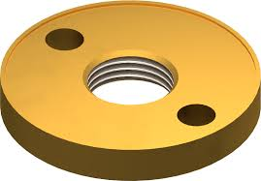
TAPPING
‹#›

Slide 34
TAPPING
To create a internal thread in a piece of material (normally metal) a tap and tap wrench are normally used, this technique is normally referred to as tapping metal or to tap metal.
When tapping metal it is important to use the correct type of tap for the item that you are drilling and also the correct type of lubricant for the particular material that you are tapping.
Taps can be made from carbon steel or high speed steel (HSS). HSS taps are normally the best quality and are the dearer of the two sets.
All taps designed to be used by hand have a square on the end which will fit into a tap wrench. The makers name and tap size is also found on the shank of the tap.
‹#›

Slide 35
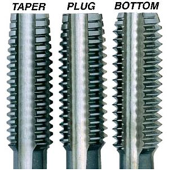
TAPPING TOOL
Hand taps come in three basic configurations -Taper, Plug and Bottoming
‹#›

Slide 36
TAPPING TOOL
TAPER taps have the first 7 – 10 threads at the tip ground flatter than the main body of the tap to enable easy starting of the threads in the hole. Sometimes called a starter tap, taper taps can be used to start the thread in a blind hole for another tap to finish or used to cut threads all the way on a through hole.
PLUG taps are like taper taps in that they have tapered threads at the starting end of the tap, the difference is there are fewer of them, usually the first 3-5 threads, so you get to cutting a full thread sooner. Although not as easy to start as a taper tap, they can be used to start a thread. If you can only buy one type of tap, and you’re a patient user, plug taps can be a good choice because they are still easy to start, but they can also form complete threads deeper into a blind hole than a taper tap.
BOTTOMING taps have no ground threads at the starting end and are generally used after, and in conjunction with a taper or plug tap. Bottom taps can cut threads to the bottom of blind holes although they do not do well at starting threads.
‹#›

Slide 37
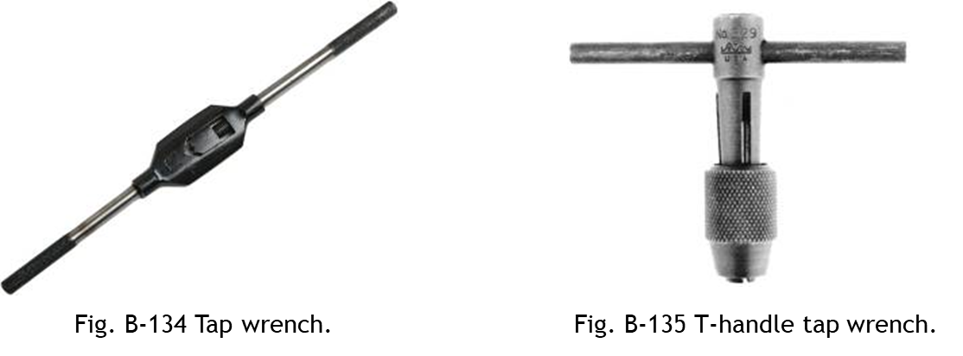
TAPPING TOOL HOLDING DEVICE
There are several different types of tap wrench available. This tap uses a chuck to hold the tap, this type is also available in a ratchet version which is useful when tapping in tight places.
A tap wrench or a T-handle tap wrench provides driving torque while hand tapping.
‹#›

Slide 38
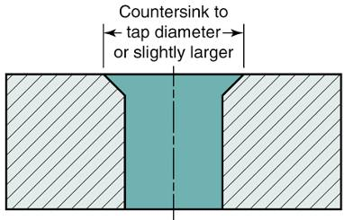
HOW TO DO TAPPING
3
Hand Tapping
Countersink the hole entrance to a diameter slightly larger than the major diameter of the threads (Fig. B-139).
This allows the tap to be started more easily & protects the start of the threads from damage.
Mount the work-piece in a bench vise so the hole is in a vertical position.
Tighten the tap in the tap wrench.
Fig. B-139 Preparing the workpiece.

Slide 39
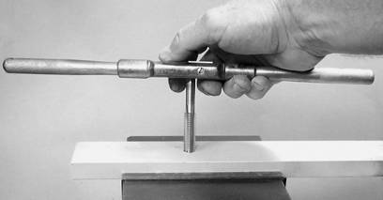
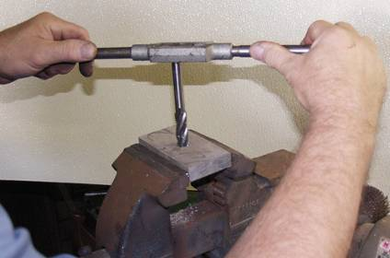
HOW TO DO TAPPING
Hand Tapping
Place the tap in the hole in a vertical position.
Start by turning 2 or 3 clockwise turns for a right-hand thread, keeping steady downward pressure on the tap.
When the tap is started, it may be turned as shown.
Starting the tap.
Tapping a thread by hand.

Slide 40
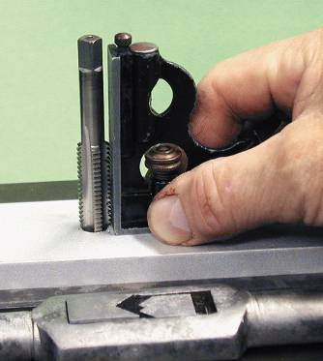
HOW TO DO TAPPING
5
Hand Tapping
After the tap is started for several turns, remove the tap wrench without disturbing the tap.
Place the blade of a square against the solid shank of the tap to check for squareness.
Check two positions 90 degrees apart.
If the tap is not square with the work, it will ruin the thread & possibly break in the hole if you continue tapping.
Back the tap out of the hole & restart.

Slide 41
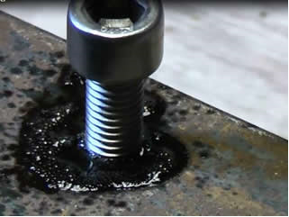
HOW TO DO TAPPING
6
Use the correct cutting oil on the tap when cutting threads.
Turn the tap clockwise one-quarter to one-half turn, then turn back three-quarters of a turn to break the chip.
Do this with a steady motion to avoid breaking the tap.
When tapping a blind hole, use the taps in the order starting, plug, and then bottoming.
Remove the chips from the hole before using the bottoming tap.
Be careful not to hit the bottom of the hole with the tap.

Slide 42
EX.NO:05 DRILLING AND TAPPING
6
AIM:
To make drill and tap on given mild steel work piece.
SUPPLIED MATERIAL SPECIFICATION:
Mild steel metal plates of dimension is (50 x 50 x 6) mm
TOOLS REQUIRED:
Hack saw frame with blade.
Try square.
Steel rule.
Jenny caliper
Files.
6) Drilling M/c.
7) Tapping M/c.
8) Dot punch.
9) Thread pitch gauge

Slide 43
EX.NO:05 DRILLING AND TAPPING
SEQUENCE OF OPERATION:
1) Preparation.
2) Marking.
3) Drilling.
4) Tapping.
5) Finishing.

Slide 44
EX.NO:05 DRILLING AND TAPPING
WORKING STEPS:
1) PREPARATION: Check the initial dimensions using steel rule. Fix the job on a bench vice and file and two adjacent sides using a flat file to form right angles. Check for the perpendicularity with try square.
2) MARKING: Apply chalk on the work surface. Measure 20mm using jenny caliper from the steel rule. Transfer the measured dimensions to the work piece with edge 12mm. Draw lines along the dimensions on work piece with scriber. Make dots along these lines using dot punch ..

Slide 45
EX.NO:05 DRILLING AND TAPPING
WORKING STEPS:
3) DRILLING: Place the work piece on the drilling machine platform. Using drilling machine make two holes on the dotted place made by dot punch. Pour some oil for smooth drill and drill the work piece properly by adjusting the pilot. Repeat the steps twice for better finishing. Lastly go to the thread pitch gauge machine & complete the drilling procedure on the work piece.
4) TAPPING: Fix the work piece in the bench vice in such a way that it should not move. Using Tapping tool 1 make threads in the holes. Repeat the procedure for both .holes, then take the taping tool 2 and use it carefully by rotating in clockwise, simultaneously do this process for both holes..

Slide 46
EX.NO:05 DRILLING AND TAPPING
WORKING STEPS:
5) FINISHING: Using a 10mm screw, check the accuracy of the finish.
RESULT:
The required holes using Drilling & Taping techniques with proper measurements has been obtained.

